Slide 1
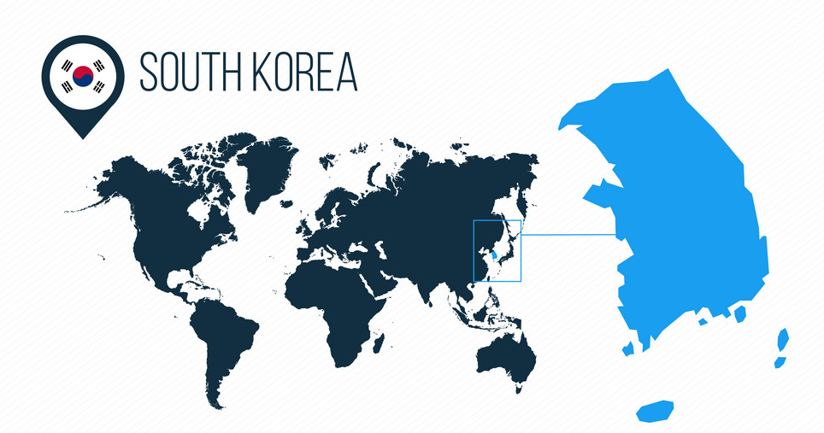
Data Science for Energy System Modelling
Assignment 4
Group K
Andrés Baidon, Julius Kiso,
Taher Muhammedali, Megan McGahren

Slide 2
Index
Input Data
Optimization
Sensitivity Analysis
Findings & Outlook
Appendix

Slide 3
INPUT DATA

Slide 4
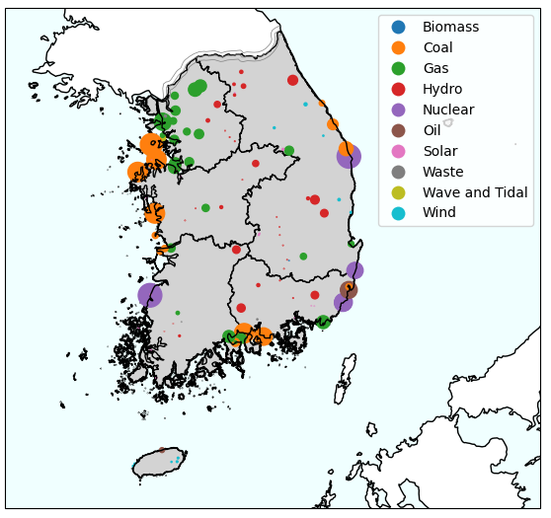
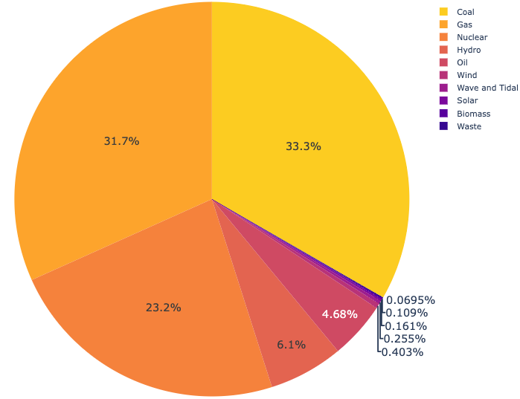
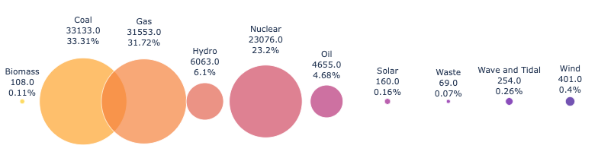
Current Situation
Existing Power Plants
Energy Sources
Heavy dependency on fossil fuels
mainly coal and gas.
85.14 M€/year
INPUT DATA

Slide 5
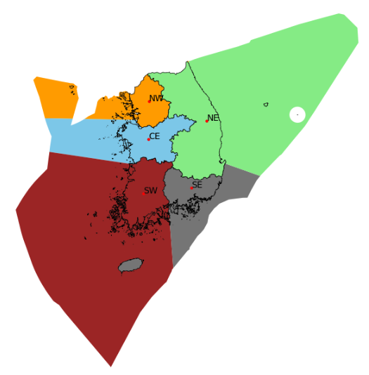
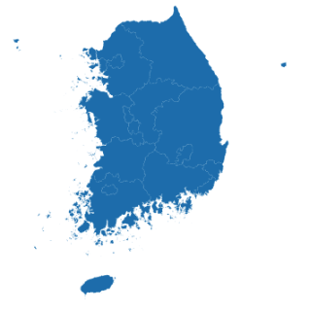
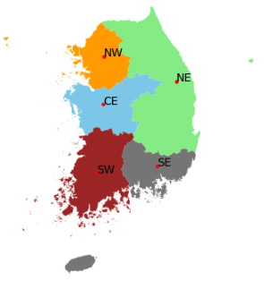
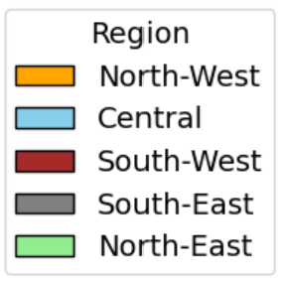
Provinces vs. Defined Regions
Sixteen South Korean Provinces
Regions with corresponding sea share
Defined regions
INPUT DATA
Notes:
redo as figure exports

Slide 6
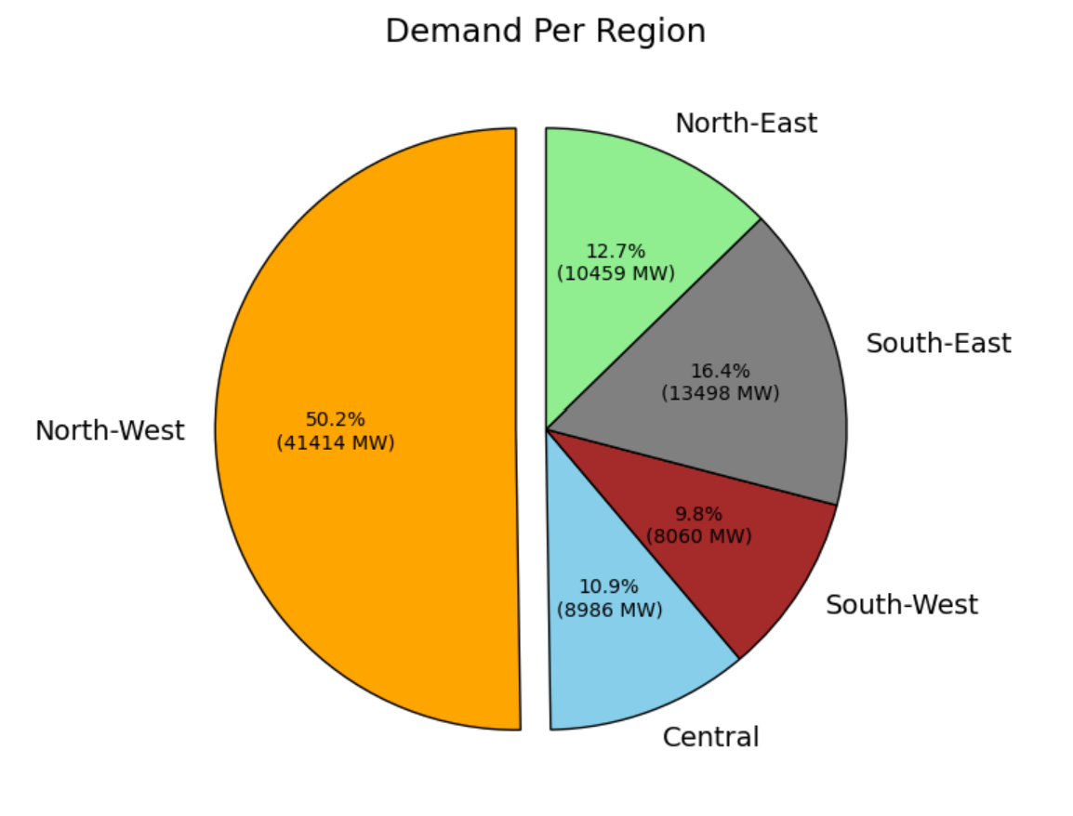
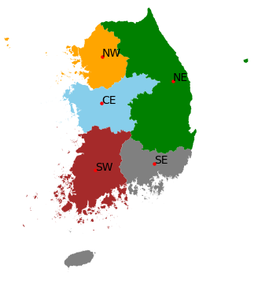
Regional Electricity Demand
INPUT DATA

Slide 7
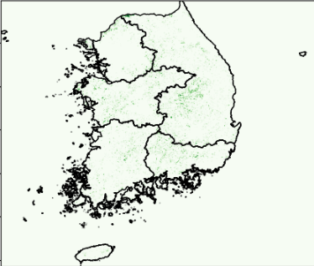
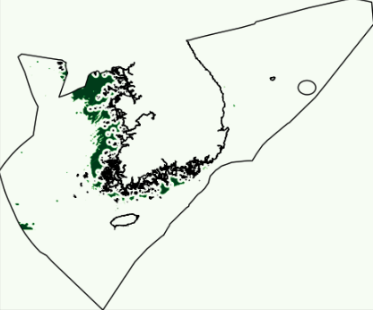
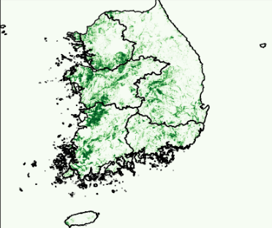
Land Eligibility
Onshore wind eligible area: 3545 km² or 2.75%
Offshore wind eligible area: 17412 km² or 4.05%
Solar eligible area: 20,480 km² or 16.37%
INPUT DATA

Slide 8
OPTIMIZATION RESULTS

Slide 9
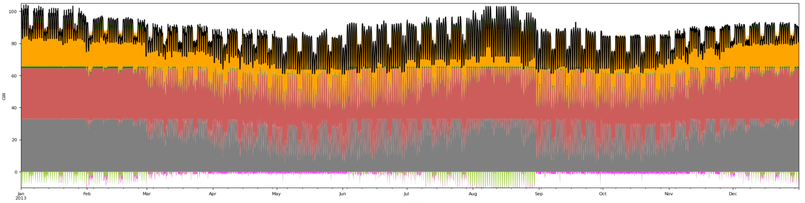
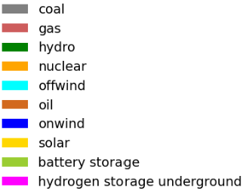
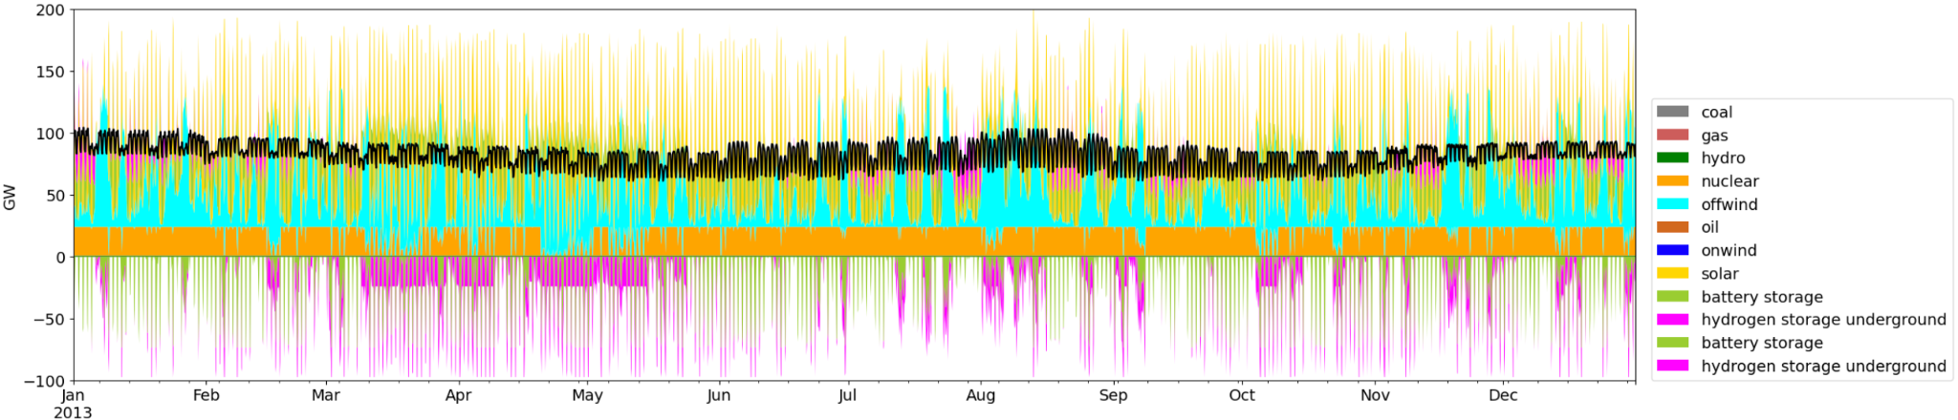
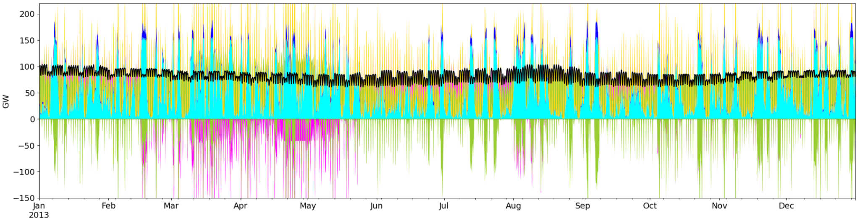
Dispatch: Base Scenario vs. Renewables
Base Scenario
No Emissions with Nuclear
No Emissions without Nuclear
OPTIMIZATION RESULTS

Slide 10
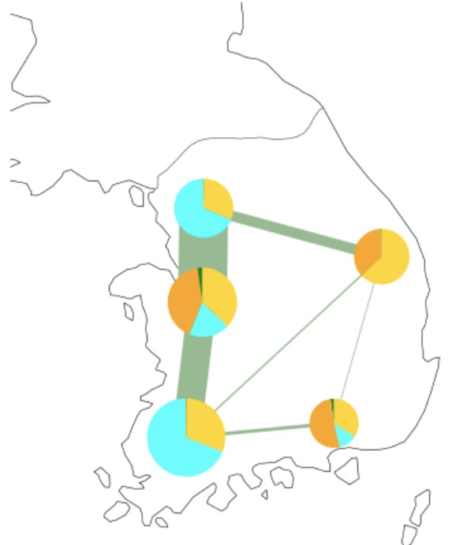
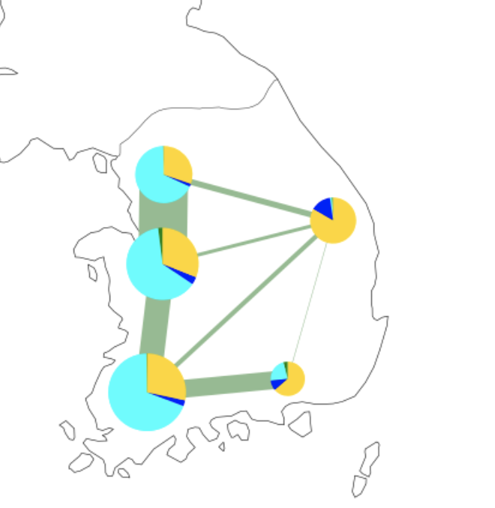
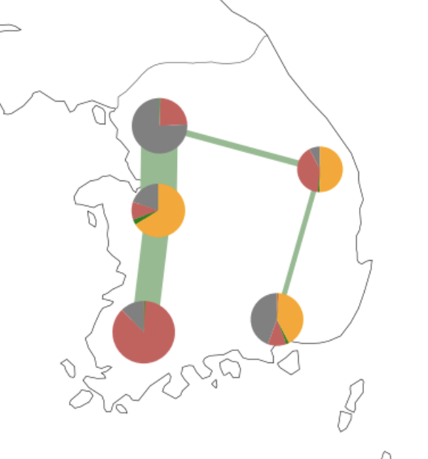
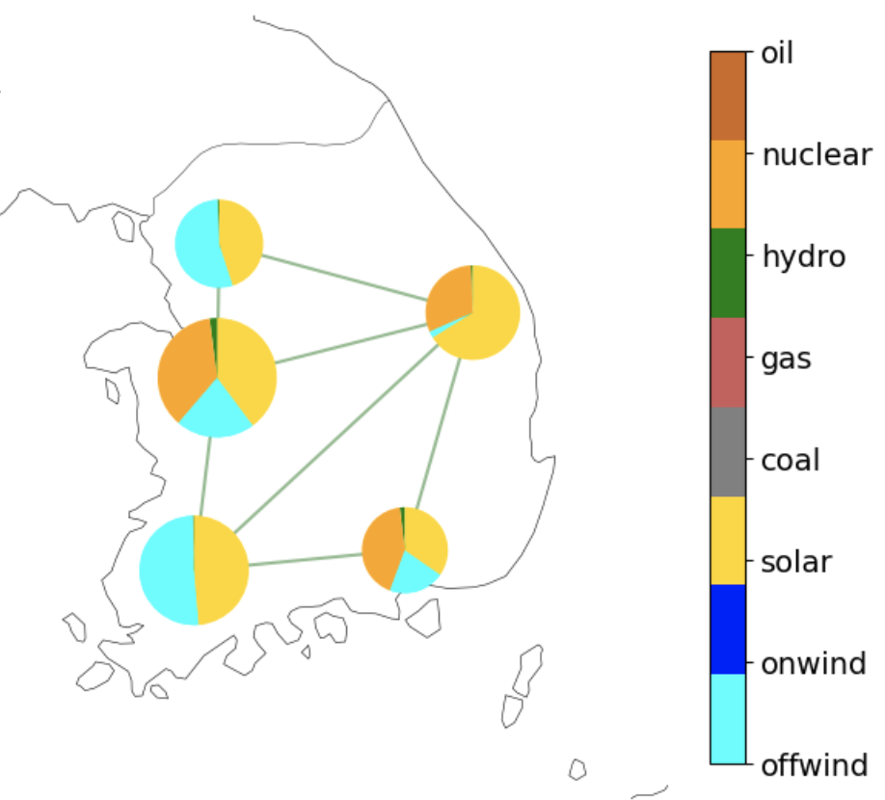
Transmission & Bus Capacities
Base Scenario
Renewables with Nuclear
Renewables without Nuclear
OPTIMIZATION RESULTS

Slide 11
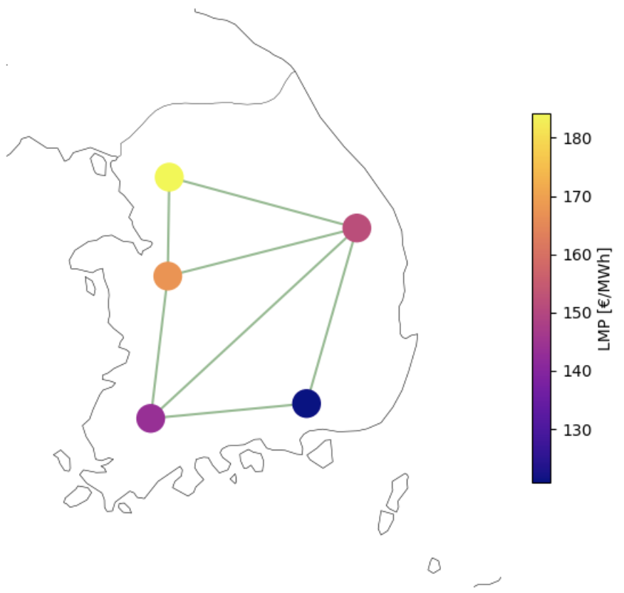
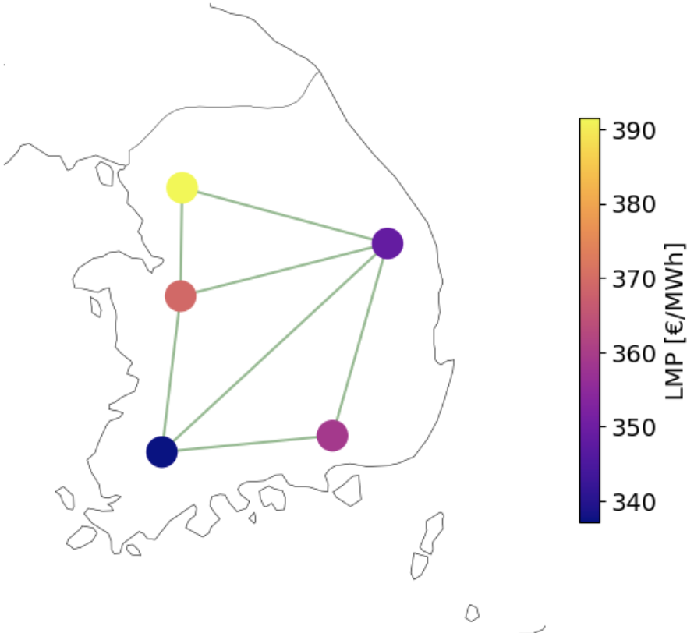
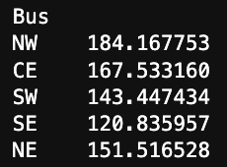
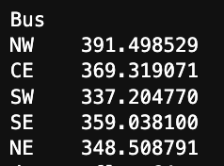
Current Electricity Cost vs. No Emissions Scenario
Base Scenario Prices
No Emission Scenario Prices
*Nuclear Included
OPTIMIZATION RESULTS

Slide 12
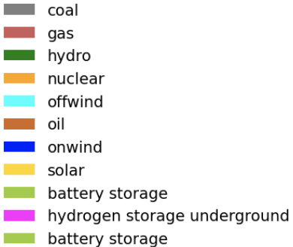
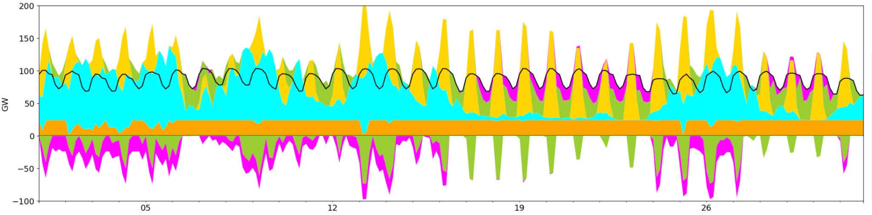
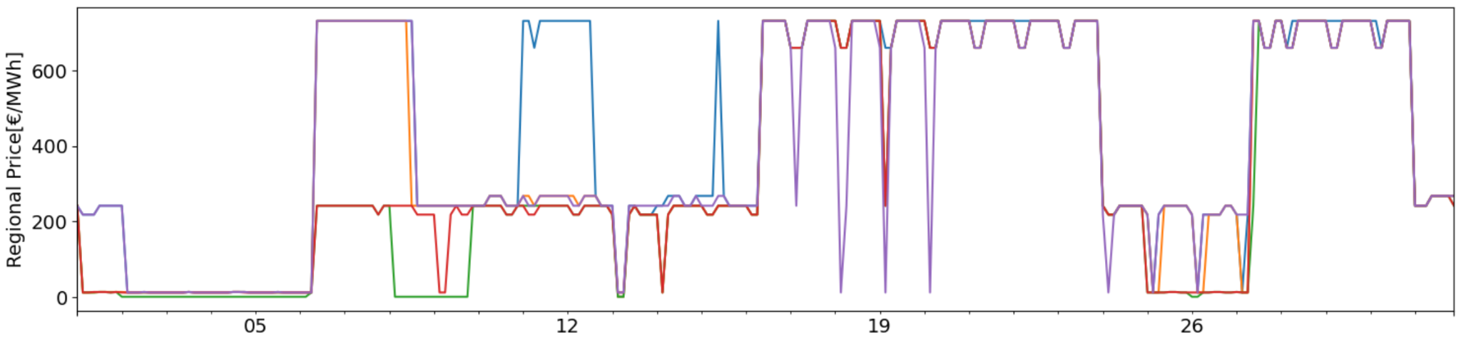
Hourly price for Electricity
More direct feed-in of Renewables
Less direct feed-in of Renewables
Plotted for Month of August
OPTIMIZATION RESULTS

Slide 13
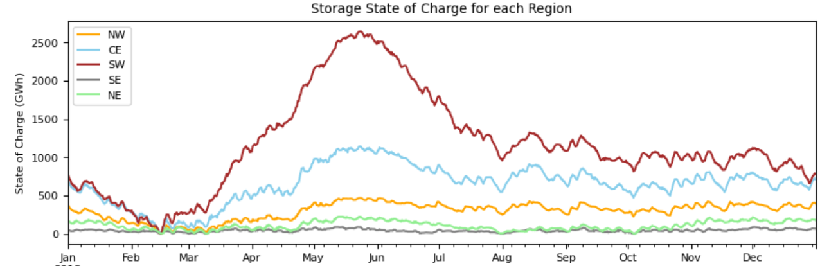
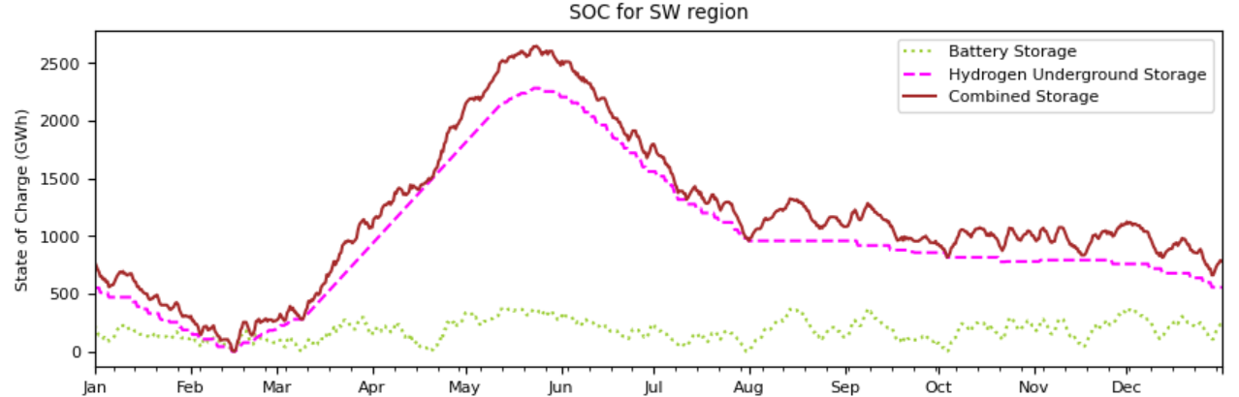
SOC for Renewables Scenario
OPTIMIZATION RESULTS

Slide 14
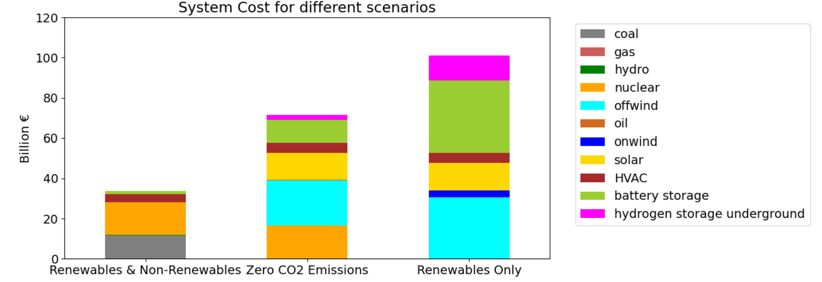
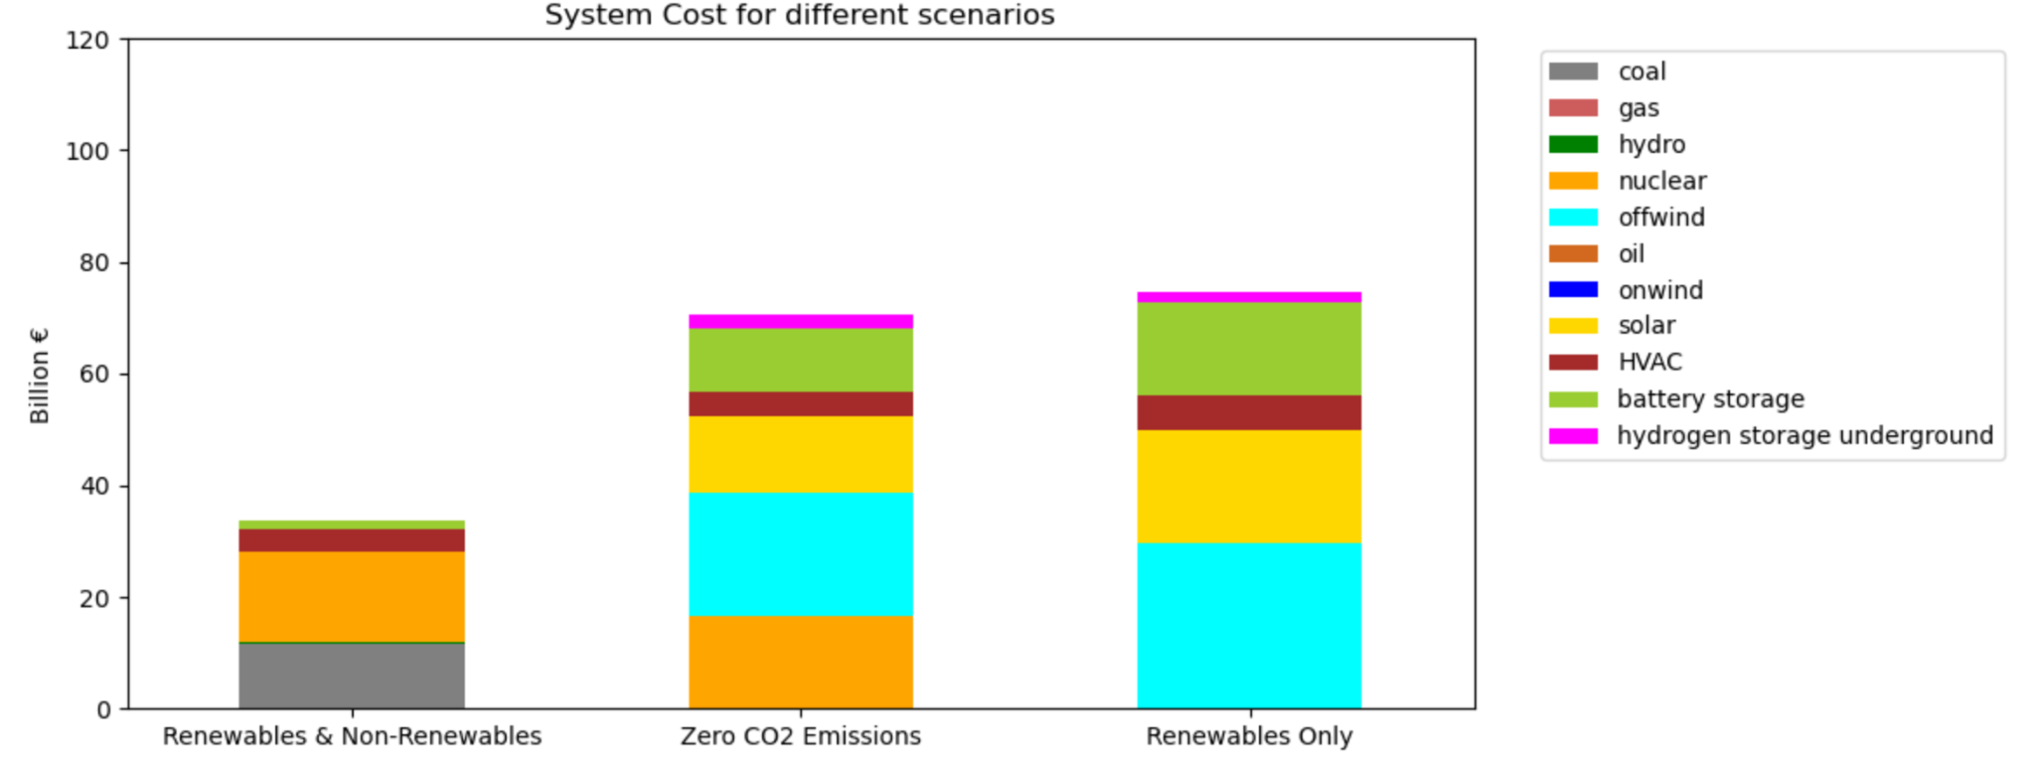
System Costs of Different Scenarios
4 times p_max
Transition from Fossils to Renewables:
6 times p_max
→ More storage costs (volatility)
→ More network capacity costs (transmission)
→ Total system costs multiply
OPTIMIZATION RESULTS

Slide 15
SENSITIVITY ANALYSIS

Slide 16
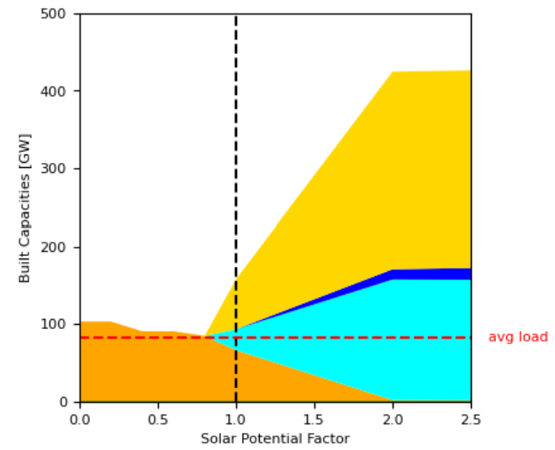
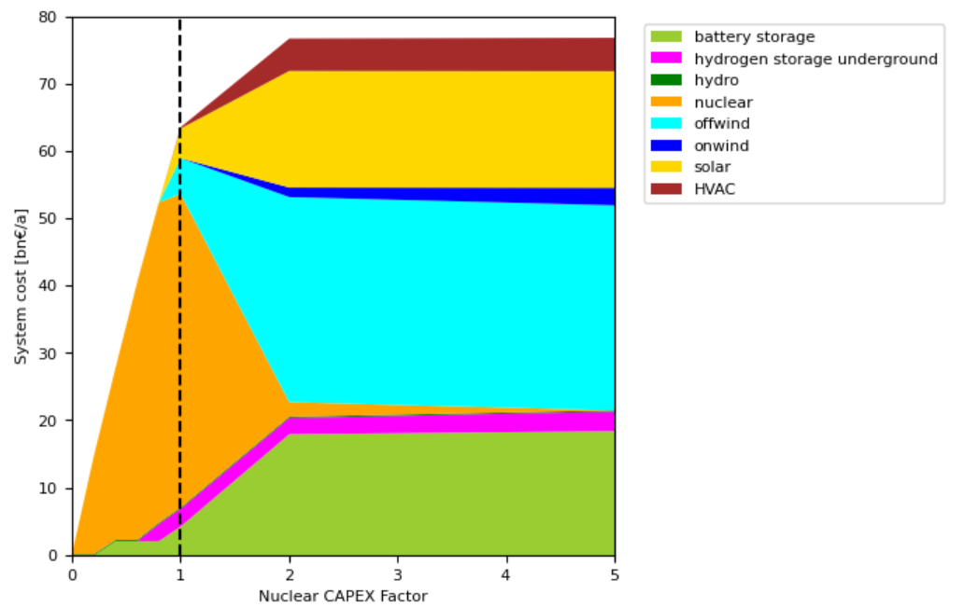
Sensitivity for Nuclear Technology
Nuclear CAPEX Factor
→ Nuclear as a big player with given technology costs
→ Storage opportunities not needed when high nuclear share
→ What are the costs for disposal and price for unminable uranium?
SENSITIVITY ANALYSIS

Slide 17
CONCLUSIONS

Slide 18
Findings
→ The current energy mix is dirty (coal, gas, (imported) oil, nuclear)
→ The population distribution (concentration around Seoul) is an additional difficulty
→ The availability of renewable energy carriers is very limited
→ High battery/H2 storages would be needed to supply the demand at any moment (no excess energy, no curtailment)
→ Nuclear is a competitive technology towards climate neutrality
→ System costs rising by multiple times
CONCLUSIONS

Slide 19
Outlook
“The Republic of Korea, the world’s 8th largest energy consumer, is an energy-poor country that relies heavily on energy imports from overseas. The country imports almost 92.8% of its energy and natural resources consumption.” Energy | Ministry of Foreign Affairs, Republic of Korea (mofa.go.kr)
"The future of korean energy will likely have to rely heavily on offshore wind installations and nuclear power. South Korea’s newly elected president, Yoon Suk-Yeol recently unveiled plans to increase the country’s share of nuclear power to 30% by 2030.”
https://www.spglobal.com/commodityinsights/en/market-insights/latest-news/energy-transition/070522-south-korean-president-unveils-energy-plan-focused-on-cutting-fossil-fuel-reliance
“South Korea to move towards the goal of carbon neutrality by 2050”
Press Release (me.go.kr)
CONCLUSIONS

Slide 20
감사합니다
Thank you
Notes:
or thank

Slide 21
APPENDIX

Slide 22
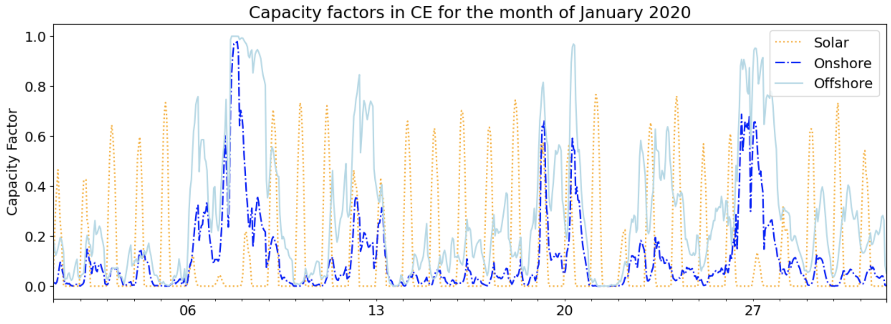
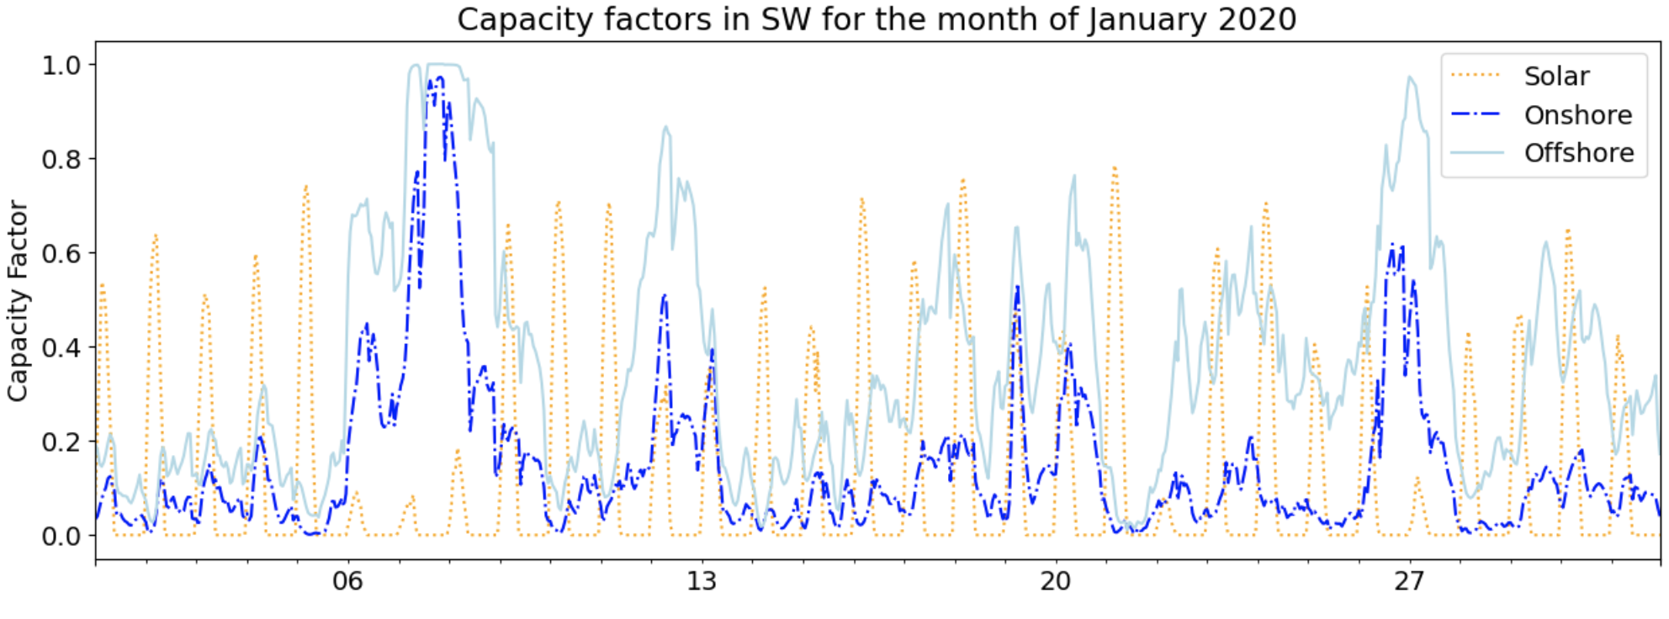
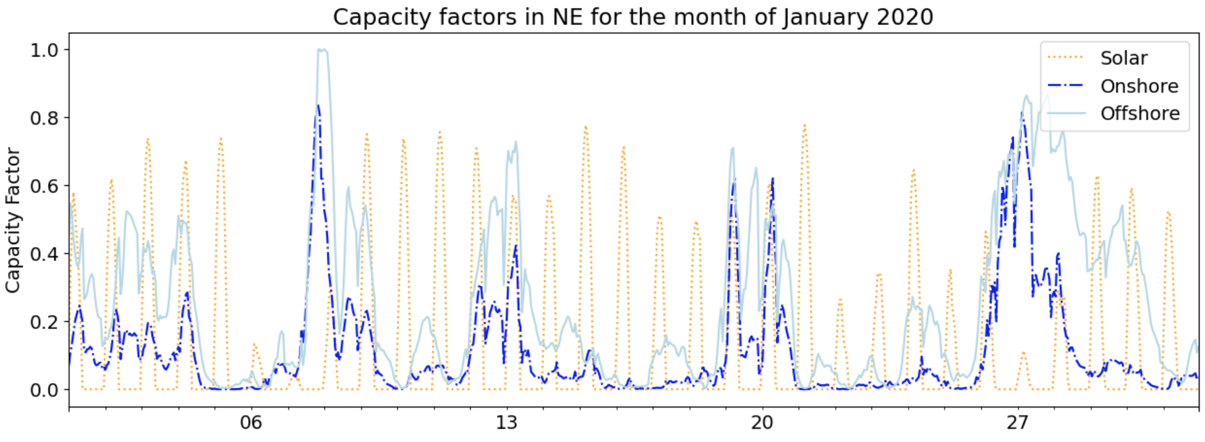
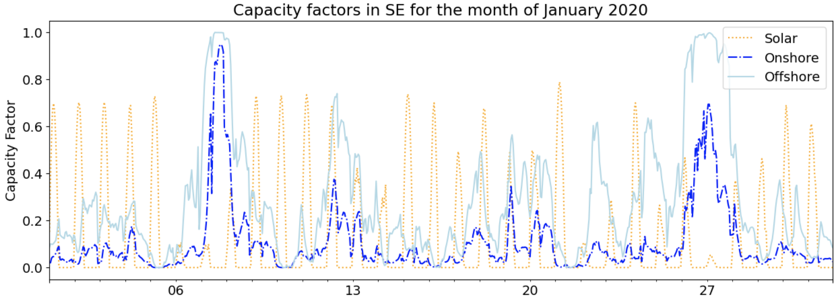
Capacity Factors for CE, SW, SE, NE
APPENDIX

Slide 23
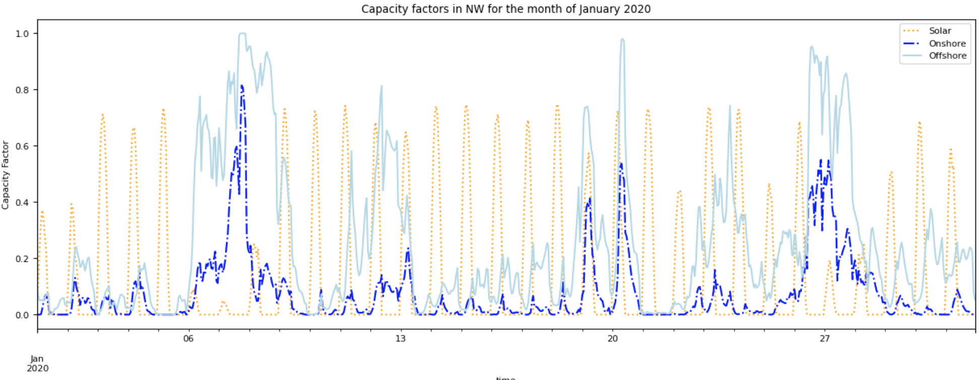
NW Capacity Factors for January 2020
NW is the most populous region
APPENDIX

Slide 24
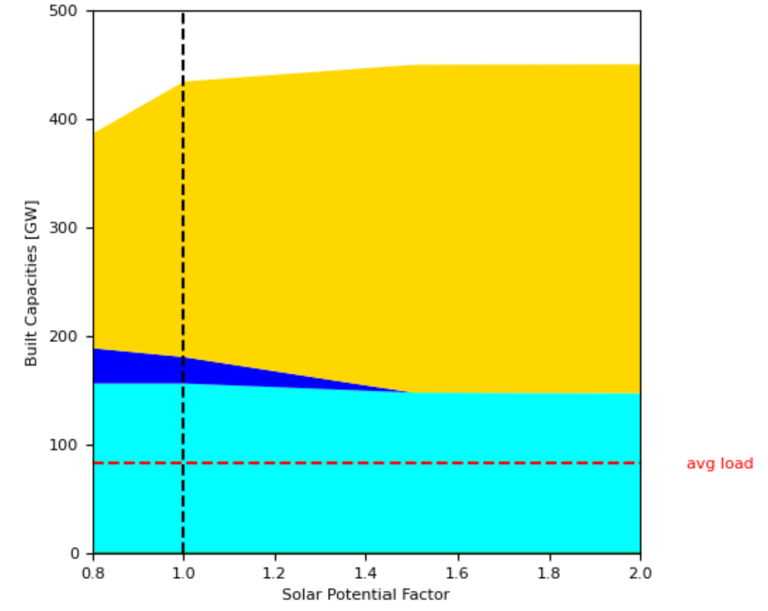
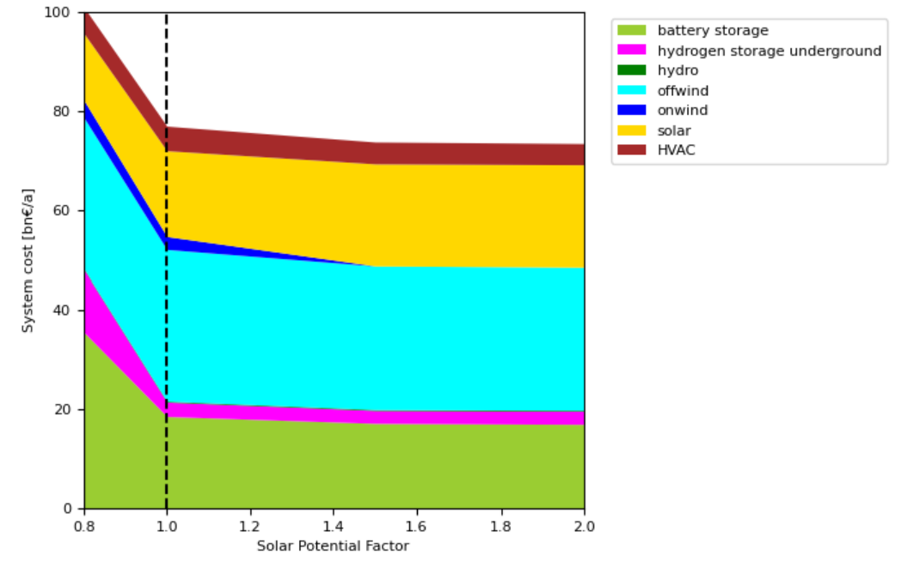
Sensitivity for Solar Availability
→ Four times more built capacities than average load (due to capacity-factor)
→ Solar substitutes onshore-wind if availability is high
→ Less solar availability leads to higher storage (H2+battery) costs
APPENDIX

Slide 25
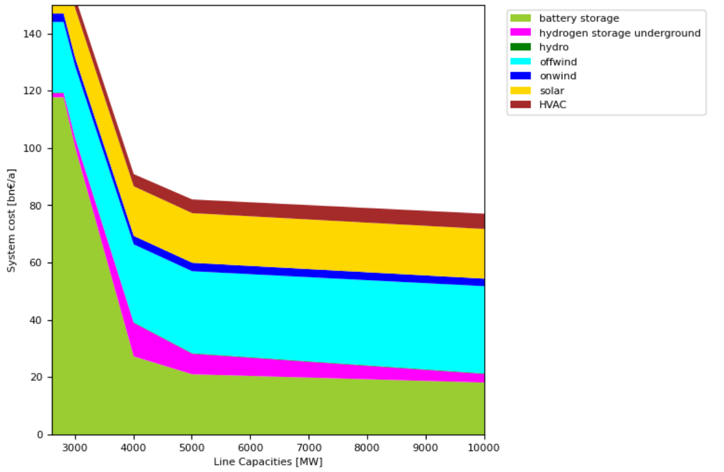
Sensitivity for Grid Capacities
→ line capacities can play a big role in renewable energy systems
→ non-linear course: costs are exponentially increasing below 5GW
→ the higher the capacity, the lower the costs → bottleneck effect
… but other external factors might constrain infinite capacity expansion
APPENDIX

Slide 26
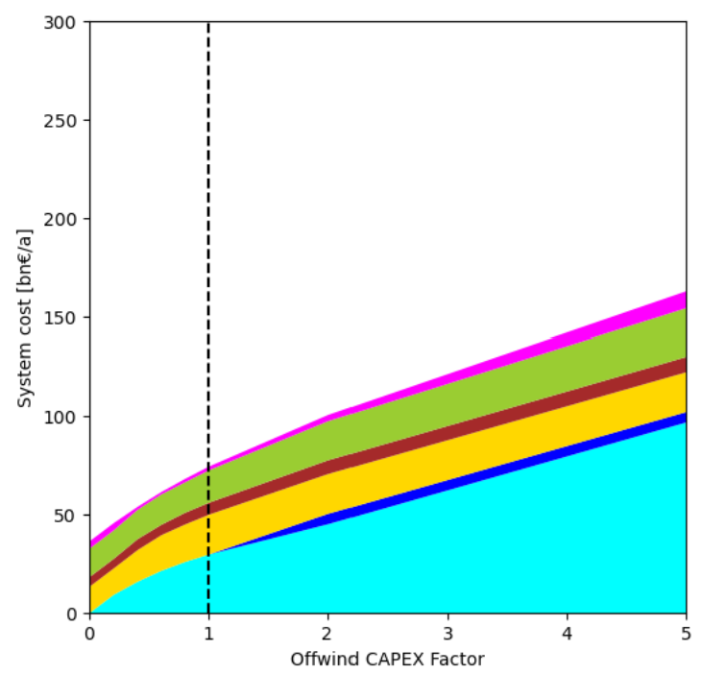
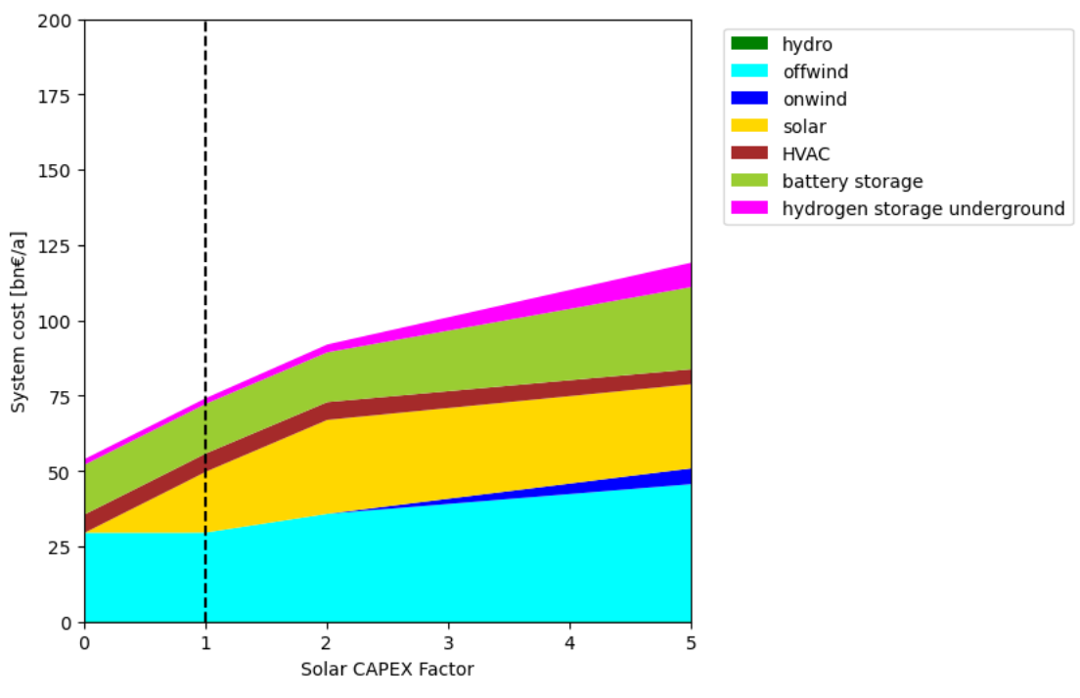
Sensitivity of CAPEX Wind/Solar
→ Little substitution of carriers (generation is almost at its limit)
→ System costs rise almost linearly with higher investment costs
→ Onshore wind as substitute technology when CAPEX rise
APPENDIX

Slide 27
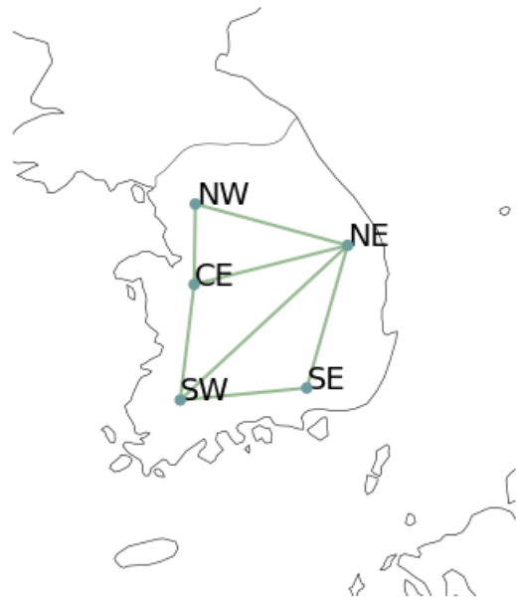
Transmission Lines
The following transmission lines were set up between buses:
APPENDIX

Slide 28
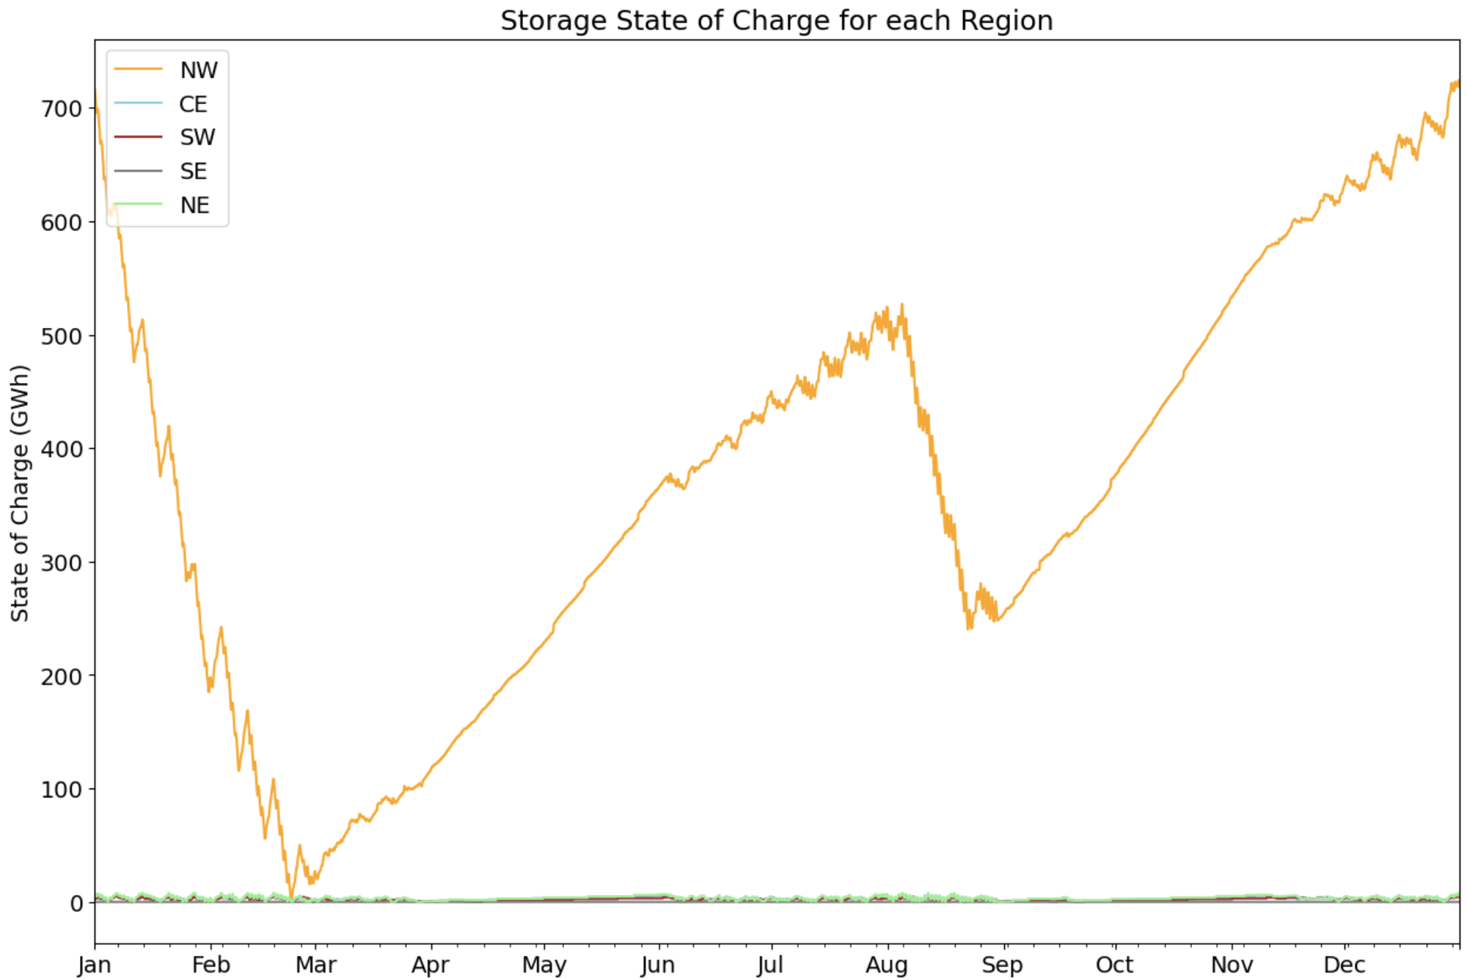
Current Regional State of Charge
APPENDIX

Slide 29
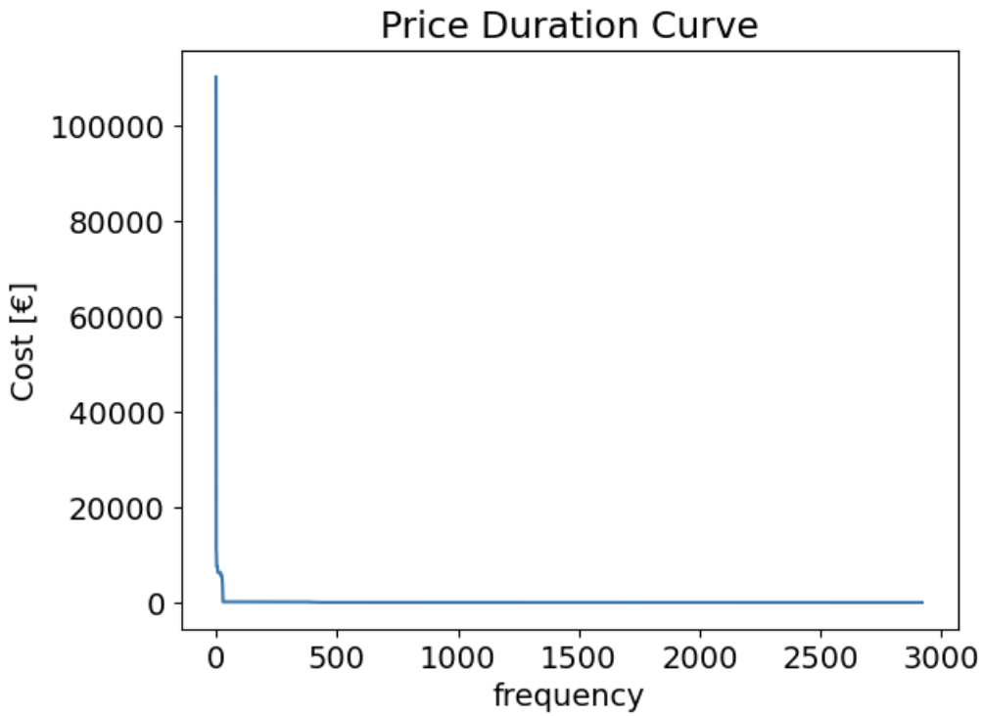
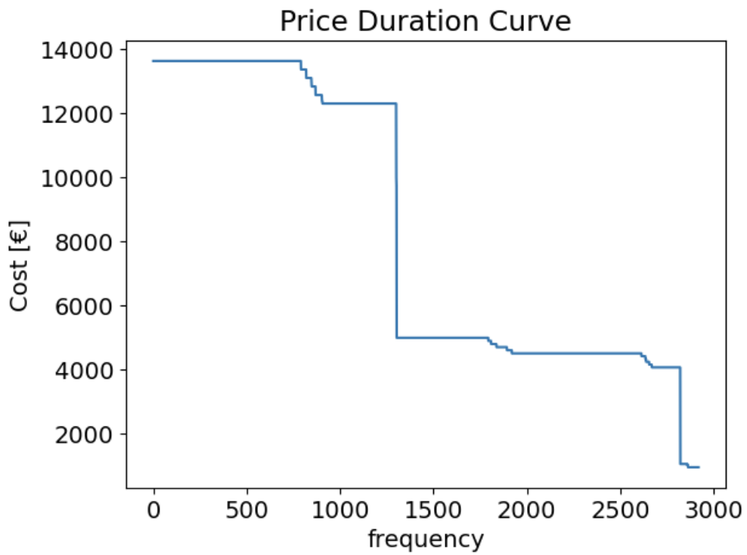
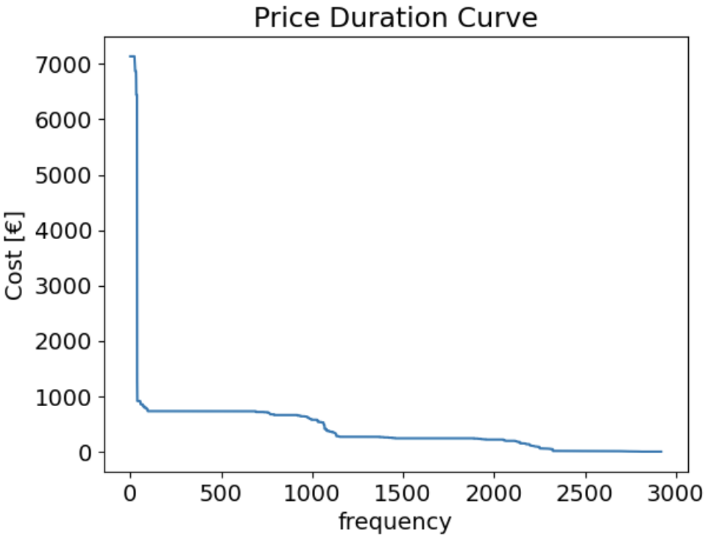
Price Duration Curves
Current Scenario
No Emissions with Nuclear
No Emissions without Nuclear
APPENDIX

Slide 30
Additional Information
The following is some additional information about South Korea that may be relevant for the presentation:
South Korea alone is about the size of Portugal or Hungary, or the U.S. state of Indiana. The largest island, Jeju-do, lies off the southwest corner of the peninsula and has a land area of 1,825 square kilometers.
https://www.infolink-group.com/energy-article/Offshore-wind-market-analysis-South-Korea-raises-capacity-target-to-18-20-GW-For-2030
According to the plan, renewable energy will make up 21.5% of the country’s total electricity generation by 2030 (9% in 2021), with the figure for coal standing at 21.2% (35% in 2021) and natural gas at 20.9% (28% in 2021). South Korea has pledged to reduce its greenhouse gas emissions by 40% by 2030 (from 2018 levels) and reach carbon neutrality by 2050.
https://www.enerdata.net/publications/daily-energy-news/south-korea-will-raise-share-nuclear-power-generation-33-2030.html
APPENDIX
Notes:
overall population
how is south korea planning to do energy transition

